Slide 1
Randomized algorithms 1 Intro, hashing
CS240 Spring 2021
Rui Fan

Slide 2
Outline
Introduction
Probability review
Max-cut and randomized quicksort
Hashing
Closed addressing
Universal hashing
Perfect hashing

Slide 3

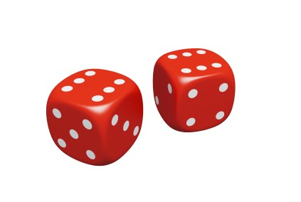
Randomized algorithms
Till now, all of our algorithms have been deterministic.
Given an input, the algorithm always does the same thing.
It turns out it’s very useful to allow algorithms to be nondeterministic.
As the algorithm operates, it’s allowed to make some random choices.
Running the algorithm multiple times on same input can produce different behaviors.

Slide 4
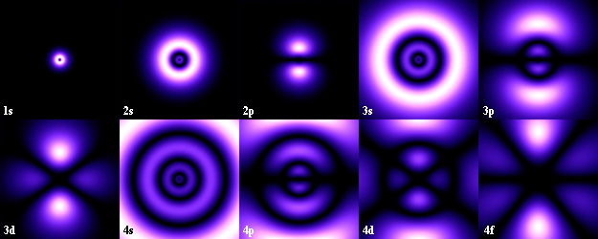
Why randomized algorithms?
For many problems, randomized algorithms work better than deterministic ones.
Faster / uses less memory
Simpler, easier to understand.
Some problems that provably can’t be solved (or solved efficiently) by deterministic algorithms can be solved by randomized ones.
According to quantum mechanics, the world is inherently probabilistic, so nature is randomized!

Slide 5
How can randomness help?
Say you have a string of length n that’s half A’s and half B’s.
We want to find a location in the string with an A.
Any deterministic algorithm takes n/2+1 steps in the worst case.
But by checking random locations, a randomized algorithm finds an A in 2 steps in expectation.

Slide 6


How can randomness help?
Measure the area of this
Method 1
Method 2
Print the shape out on a piece of paper.
Throw 100 darts at it.
See what percent land in the shape.
Multiply by area of your paper.

Slide 7
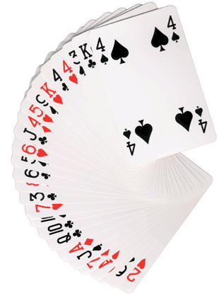
Las Vegas vs Monte Carlo
A Las Vegas randomized algorithm always produces the right answer. But it’s running time can vary depending on its random choices.
We want to minimize the expected running time of a Las Vegas algorithm.
A Monte Carlo algorithm always has the same running time. But it sometimes produces the wrong answer, depending on its random choices.
We want to minimize the error probability of a Monte Carlo algorithm.

Slide 8
Probability review
Discrete probability theory is based on events and their probabilities.
Events can be composed of more basic events.
Ex Event of rolling a 2 on a fair dice, with probability 1/6.
Ex Event of rolling an even number, with probability ½. Composed of basic events of rolling a 2, 4 or 6.
If A is event, write Pr[A]=y. E.g. Pr[roll a 2]=1/6
Two events A, B are independent if Pr[A∧B]=Pr[A]*Pr[B].
Ex Events A=“2 on first roll” and B=“3 on second roll” are independent, because Pr[A∧B]=1/36=Pr[A]*Pr[B]=1/6*1/6.
Ex Events A=“2 on first roll” and B=“the two rolls sum to 5” are not independent, because Pr[A∧B]=1/36≠Pr[A]*Pr[B]=1/6*4/36.

Slide 9
Probability review
Random variables
A variable which takes values with certain probabilities. The probabilities sum to 1.
Ex X = value from roll of dice. Values are {1,2,3,4,5,6}, each with probability 1/6.
Ex Y = number of heads in 4 flips of fair coin. Values are {0,1,2,3,4}, with probabilities {1/16,4/16,6/16,4/16,1/16}.
Ex Z = number of flips of fair coin till first head. Values are {1,2,3,...}, with probabilities {1/2,1/4,1/8,...}.
We write Pr[X=x]=y, e.g. Pr[Z=3]=1/8.

Slide 10
Probability review
Expectation of random variable X
E[X]=Σ_{x} x*Pr[X=x].
The average value of X, over many trials.
Ex X=number of heads in 4 flips. E[X]=0*1/16+1*4/16+2*6/16+3*4/16+4*1/16=2.
If you flip a coin 4 times, for 1000 times, on average you see 2 heads per 4 flips.
An indicator variable X for a event E is a random variable that’s 1 of E occurs, and 0 otherwise.
If event E has probability p of occurring, and X is E’s indicator variable, then E[X]=p.
Because E[X]=Pr[E occurs]*1+Pr[E doesn’t occur]*0=p.
This is a convenient fact we’ll frequently use.

Slide 11
Probability review
Linearity of expectations
Given random variables X, Y, E[X+Y]=E[X]+E[Y].
Extends to any number of random variables, e.g. E[X+Y+Z]=E[X]+E[Y]+E[Z].
The random variables do not have to be independent.
Very useful property!
Ex Let X=number of heads in 100 coin flips. Calculate E[X].
Direct method: 1*Pr[1 head]+2*Pr[2 heads]+...+100*Pr[100 heads], a very complicated sum.
Linearity method: X=X₁+X₂+...+X₁₀₀, where X_{i}=number of heads on i’th flip.
E[X_{i}]=0*Pr[0 heads]+1*Pr[1 head]=1/2.
E[X]=E[X₁]+...+E[X₁₀₀]=100/2=50.

Slide 12
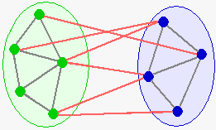
Problem 1: Max-Cut
We studied the Min-Cut problem, which is closely related to finding the max flow in a network.
Max-Cut is the opposite of Min-Cut.
Given a graph G, split vertices into two sides to maximize the number of edges between the sides.

Slide 13
Max-Cut
Unlike Min-Cut, Max-Cut is NP-complete.
We’ll give a very simple randomized Monte Carlo 2-approximation algorithm.
Monte Carlo means the algorithm sometimes returns the wrong answer, i.e. a cut that’s not a 2-approximation.
Monte Carlo also means the algorithm always runs in a fixed amount of time.
Put each node in a random side with probability ½.

Slide 14
Correctness
Lemma In a graph with e edges, the algorithm produces a cut with expected size e/2.
Proof Let X be a random variable equal to the size of the cut. We want to bound E[X].
For each edge e, let X_{e} be the indicator variable of whether e is in the cut.
I.e. X_{e}=1 if e is in the cut and 0 otherwise.
So X= Σ_{e} X_{e}.
Given an edge e=(i,j), e is in the cut if i and j are on different sides.
So Pr[e in cut]=Pr[(i in L) ∧ (j in R)] + Pr[(j in L) ∧ (i in R)]=1/4+1/4=1/2.
So E[X_{e}]=1/2.
So E[X]=e/2 by linearity of expectations.

Slide 15
Correctness
Since a cut can have at most e edges, the e/2 edges the algorithm outputs in expectation is a 2 approximation.
Note that we only bounded expected size of the algorithm’s cut.
In any particular execution, the algorithm can output a cut that’s smaller or larger than e/2.
On average, the cut has size e/2.
It’s possible to bound the probability the algorithm outputs a cut significantly smaller than e/2, but we won’t do this.

Slide 16
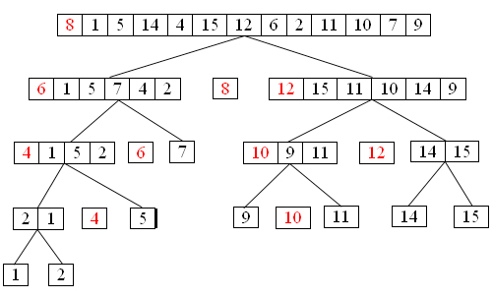
Problem 2: Quicksort
Recall the Quicksort algorithm.
Pick a pivot element s.
Partition the elements into two sets, those less than s and those more than s.
Recursively Quicksort the two sets.

Slide 17


Complexity of Quicksort
Let T(n) be the time to Quicksort n numbers.
T(n) is small in practice.
But in the worst case, T(n)=O(n²).
Occurs with very uneven splits. I.e. the rank of the pivot is very small or large.
Ex If pivot is smallest element, then T(n)=T(1)+T(n-1)+n-1. This solves to T(n)=O(n²).
T(1) and T(n-1) to recursively sort each side, n-1 to partition the elements wrt the pivot.
As long as the pivot is near the middle, Quicksort takes O(n log n) time.
Ex If the pivot is always in the middle half, [n/4, 3n/4], then T(n) ≤ T(n/4)+T(3n/4)+n-1, which solves to O(n log n).

Slide 18
Randomized Quicksort
Quicksort is only slow if we keep picking very small or large pivots.
Let’s pick the pivot at random. Intuitively, we shouldn’t be unlucky and always pick small or large pivots.
Pick a random pivot element s.
Partition the elements into two sets, those less than s and those more than s.
Recursively RQuicksort the two sets.

Slide 19
Complexity of RQuicksort
Let R(n) be the expected time to RQuicksort n numbers.
With probability 1/n, the pivot has rank 1 (is smallest element), in which case R(n)=R(1)+R(n-1)+n-1.
With probability 1/n, the pivot has rank 2, and R(n)=R(2)+R(n-2)+n-1.
...
With probability 1/n, the pivot has rank k, and R(n)=R(k)+R(n-k)+n-1.
Putting these together, we have
R(n) = 1/n*(R(1)+R(n-1)+R(2)+R(n-2)+...+R(n-1)+R(1) + n*1/n*(n-1) =
2/n*Σ_{k} R(k) + n-1.

Slide 20
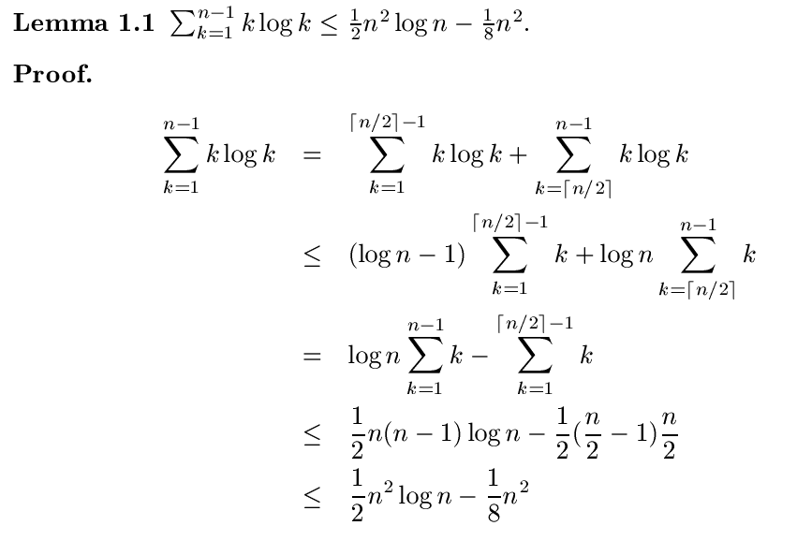
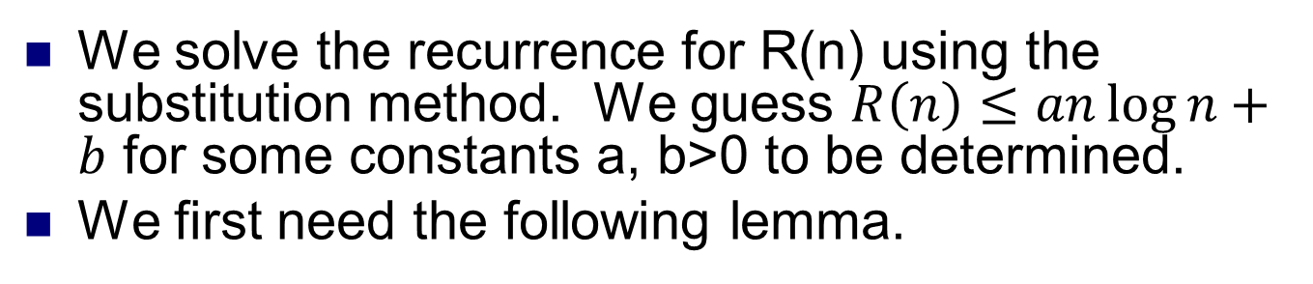
Complexity of RQuicksort
We solve the recurrence for R(n) using the substitution method. We guess $R\left(n\right)≤an\log{n}+b$ for some constants a, b>0 to be determined.
We first need the following lemma.

Slide 21
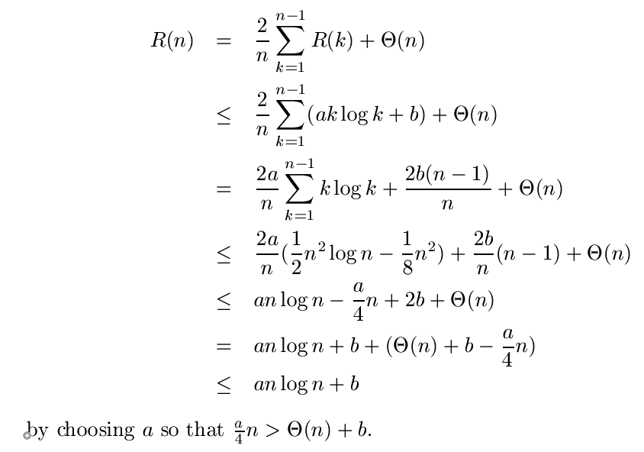
Complexity of RQuicksort
Now we can solve for R(n).

Slide 22
Hash tables
A hash table is a randomized data structure to efficiently implement a dictionary.
Supports find, insert, and delete operations all in expected O(1) time.
But in the worst case, all operations are O(n).
The worst case is provably very unlikely to occur.
A hash table does not support efficient min / max or predecessor / successor functions.
All these take O(n) time on average.
A practical, efficient alternative to binary search trees if only find, insert and delete needed.

Slide 23
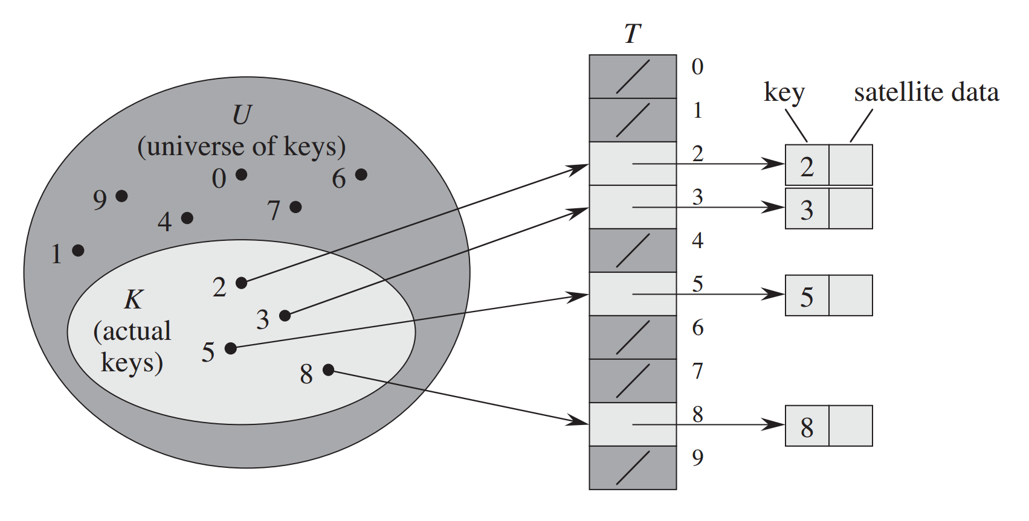
Direct addressing
Suppose we want to store (key, value) pairs, where keys come from a finite universe U = {0, 1, ..., m-1}.
Use an array of size m.
insert(k, v) Store v in array position k.
find(k) Return the value in array position k.
delete(k) Clear the value in array position k.
All operations take O(1) time.
The problem is, if m is large, then we need to use a lot of memory.
Uses O(|U|) space.
Ex For 32 bit keys, need 4 GB memory. For 64 bit keys, more memory than in world.
Ex What about string based keys?
Also, if only need to store few values, lots of space wasted.
Source: Introduction to Algorithms, Cormen et al

Slide 24
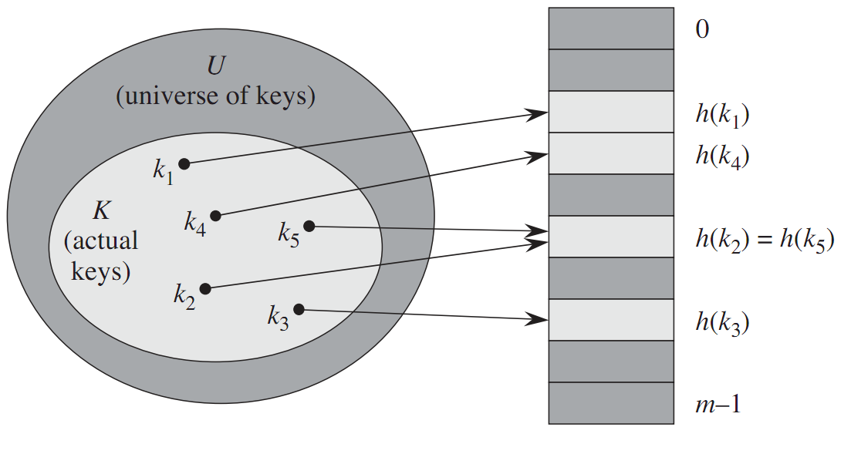
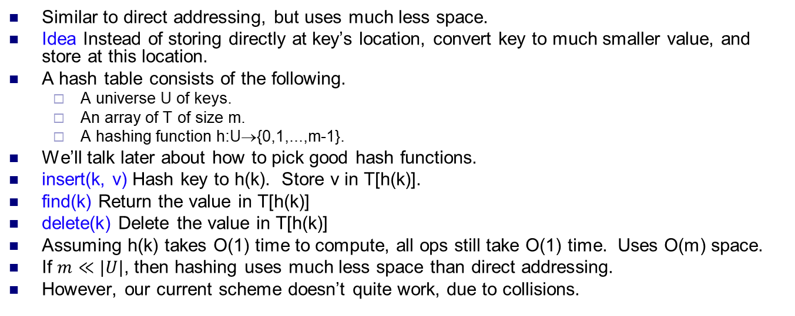
Hash table
Similar to direct addressing, but uses much less space.
Idea Instead of storing directly at key’s location, convert key to much smaller value, and store at this location.
A hash table consists of the following.
A universe U of keys.
An array of T of size m.
A hashing function h:U→{0,1,...,m-1}.
We’ll talk later about how to pick good hash functions.
insert(k, v) Hash key to h(k). Store v in T[h(k)].
find(k) Return the value in T[h(k)]
delete(k) Delete the value in T[h(k)]
Assuming h(k) takes O(1) time to compute, all ops still take O(1) time. Uses O(m) space.
If $m≪|U|$, then hashing uses much less space than direct addressing.
However, our current scheme doesn’t quite work, due to collisions.

Slide 25
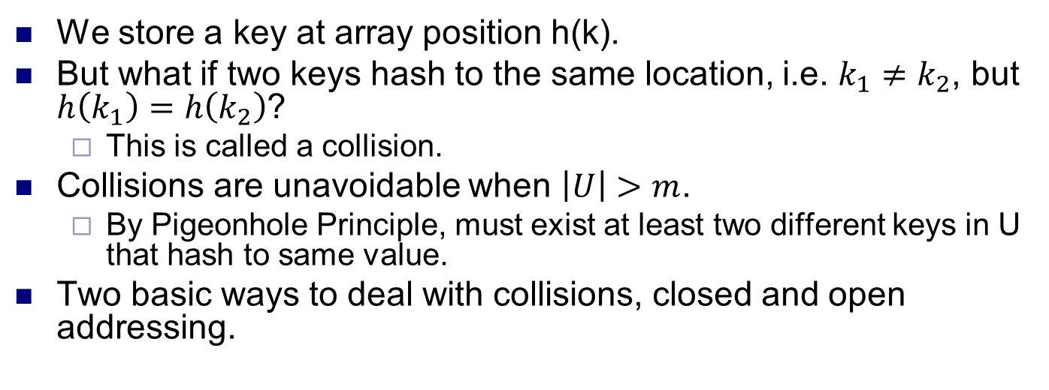
Collisions
We store a key at array position h(k).
But what if two keys hash to the same location, i.e. $k_{1}≠k_{2}$, but $h\left(k_{1}\right)=h\left(k_{2}\right)$?
This is called a collision.
Collisions are unavoidable when $\left|U\right|>m$.
By Pigeonhole Principle, must exist at least two different keys in U that hash to same value.
Two basic ways to deal with collisions, closed and open addressing.

Slide 26
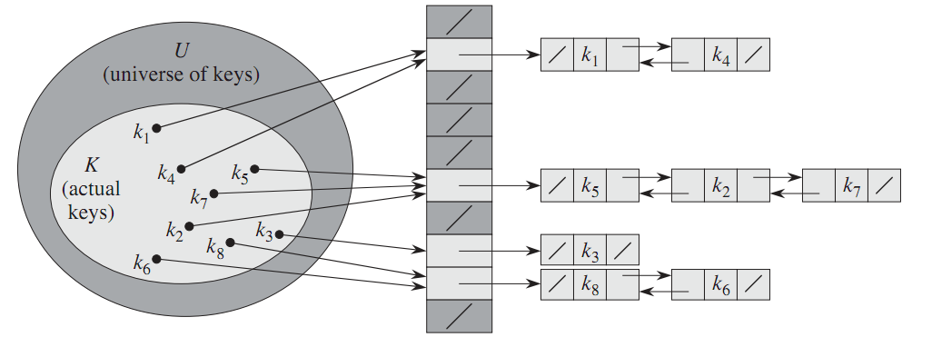
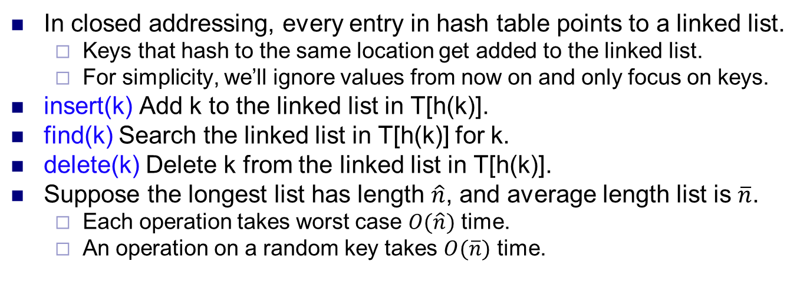
Closed addressing
In closed addressing, every entry in hash table points to a linked list.
Keys that hash to the same location get added to the linked list.
For simplicity, we’ll ignore values from now on and only focus on keys.
insert(k) Add k to the linked list in T[h(k)].
find(k) Search the linked list in T[h(k)] for k.
delete(k) Delete k from the linked list in T[h(k)].
Suppose the longest list has length $\hat{n}$, and average length list is $\overline{n}$.
Each operation takes worst case $O(\hat{n})$ time.
An operation on a random key takes $O(\overline{n})$ time.

Slide 27
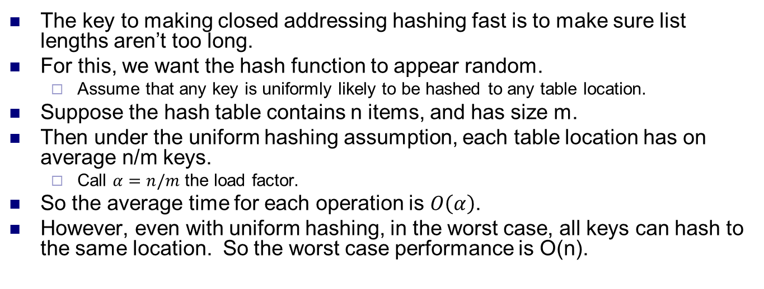
Load factor
The key to making closed addressing hashing fast is to make sure list lengths aren’t too long.
For this, we want the hash function to appear random.
Assume that any key is uniformly likely to be hashed to any table location.
Suppose the hash table contains n items, and has size m.
Then under the uniform hashing assumption, each table location has on average n/m keys.
Call $α=n/m$ the load factor.
So the average time for each operation is $O\left(α\right)$.
However, even with uniform hashing, in the worst case, all keys can hash to the same location. So the worst case performance is O(n).

Slide 28
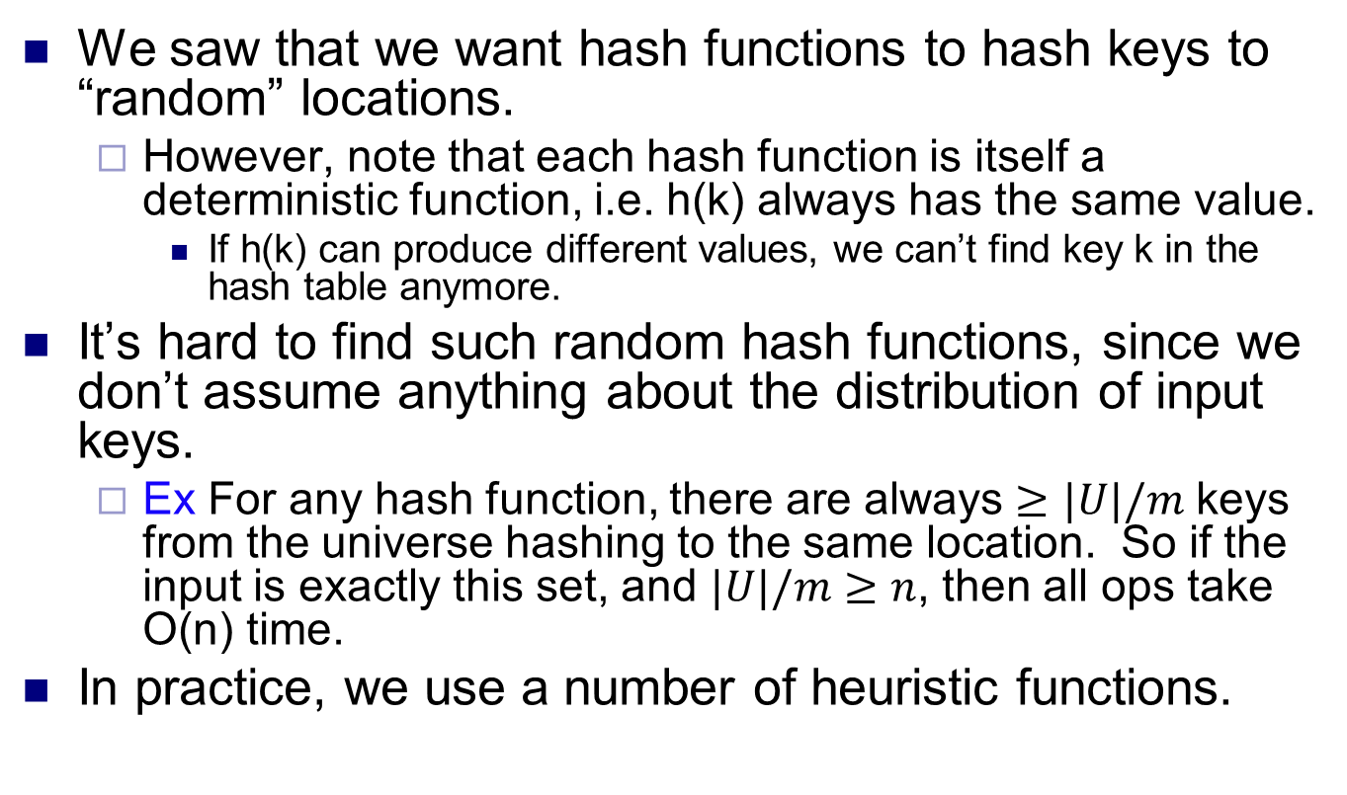
Picking a hash function
We saw that we want hash functions to hash keys to “random” locations.
However, note that each hash function is itself a deterministic function, i.e. h(k) always has the same value.
If h(k) can produce different values, we can’t find key k in the hash table anymore.
It’s hard to find such random hash functions, since we don’t assume anything about the distribution of input keys.
Ex For any hash function, there are always $≥|U|/m$ keys from the universe hashing to the same location. So if the input is exactly this set, and $|U|/m≥n$, then all ops take O(n) time.
In practice, we use a number of heuristic functions.

Slide 29
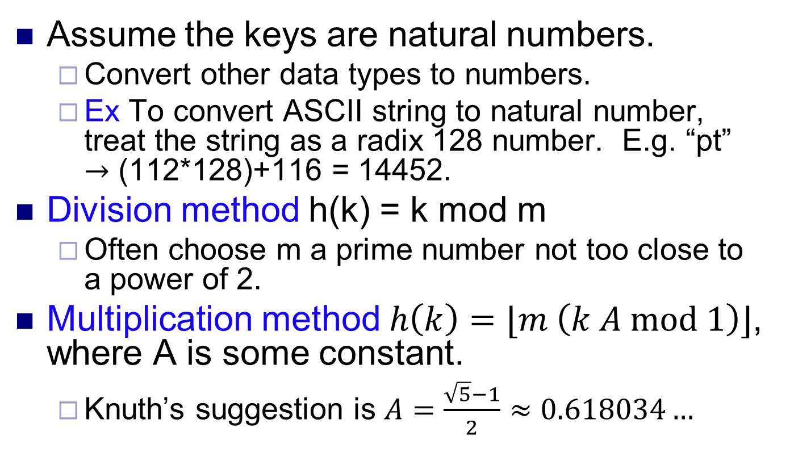
Heuristic hash functions
Assume the keys are natural numbers.
Convert other data types to numbers.
Ex To convert ASCII string to natural number, treat the string as a radix 128 number. E.g. “pt” $→$ (112*128)+116 = 14452.
Division method h(k) = k mod m
Often choose m a prime number not too close to a power of 2.
Multiplication method $h\left(k\right)=⌊m \left(k A mod 1\right)⌋$, where A is some constant.
Knuth’s suggestion is $A=\frac{\sqrt{5}−1}{2}≈0.618034…$

Slide 30
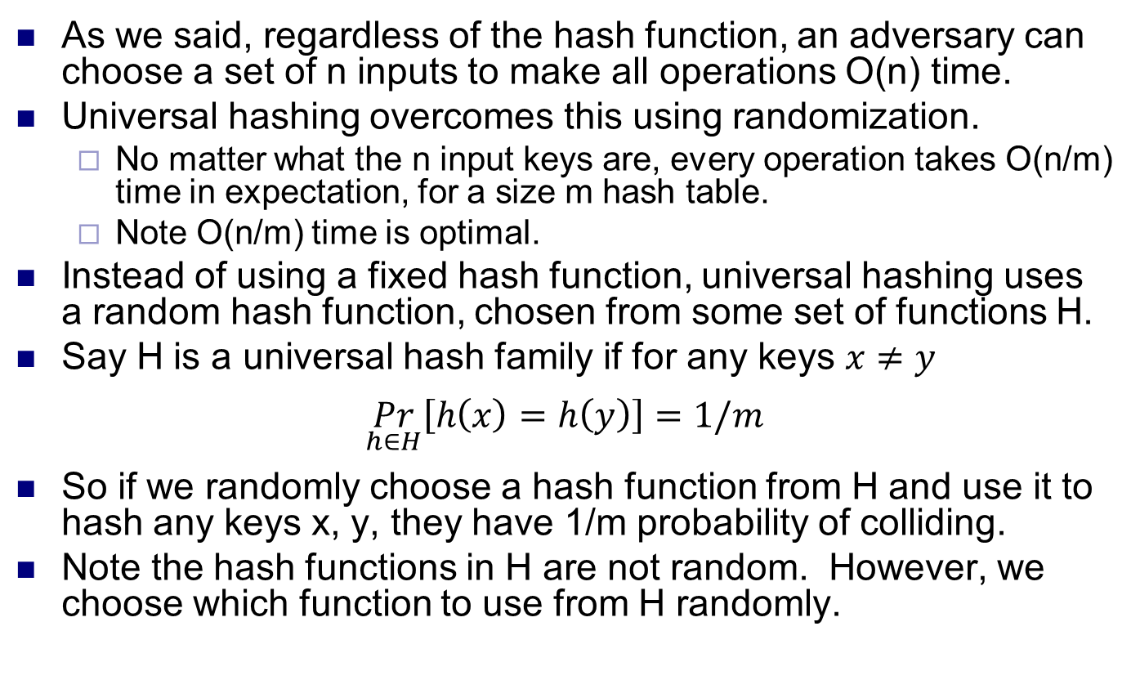
Universal hashing
As we said, regardless of the hash function, an adversary can choose a set of n inputs to make all operations O(n) time.
Universal hashing overcomes this using randomization.
No matter what the n input keys are, every operation takes O(n/m) time in expectation, for a size m hash table.
Note O(n/m) time is optimal.
Instead of using a fixed hash function, universal hashing uses a random hash function, chosen from some set of functions H.
Say H is a universal hash family if for any keys $x≠y$
$$\underset{h∈H}{Pr}\left[h\left(x\right)=h\left(y\right)\right]=1/m$$
So if we randomly choose a hash function from H and use it to hash any keys x, y, they have 1/m probability of colliding.
Note the hash functions in H are not random. However, we choose which function to use from H randomly.

Slide 31
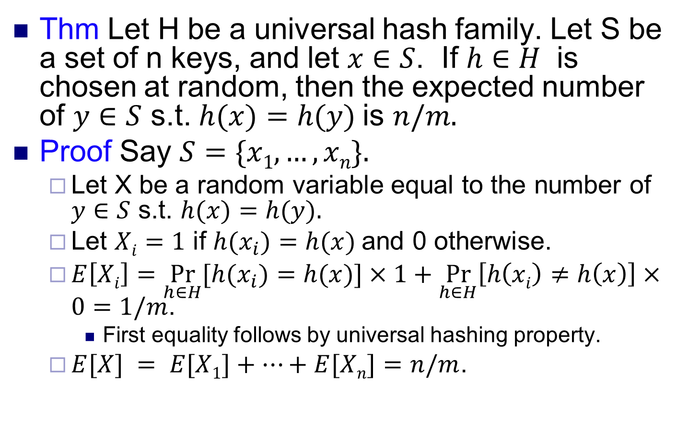
Universal hashing
Thm Let H be a universal hash family. Let S be a set of n keys, and let $x∈S$. If $h∈H$ is chosen at random, then the expected number of $y∈S$ s.t. $h(x)=h(y)$is $n/m.$
Proof Say $S=\{x1,…,xn\}.$
Let X be a random variable equal to the number of $y∈S$ s.t. $h(x)=h(y).$
Let $Xi=1$ if $h(x_{i})=h(x)$and 0 otherwise.
$E\left[Xi\right]=\underset{h∈H}{Pr}{[h(x_{i})=h(x)]}×1+\underset{h∈H}{Pr}\left[h\left(xi\right)≠h\left(x\right)\right]×0=1/m$.
First equality follows by universal hashing property.
$E[X] = E[X1]+…+E[Xn]=n/m$.

Slide 32
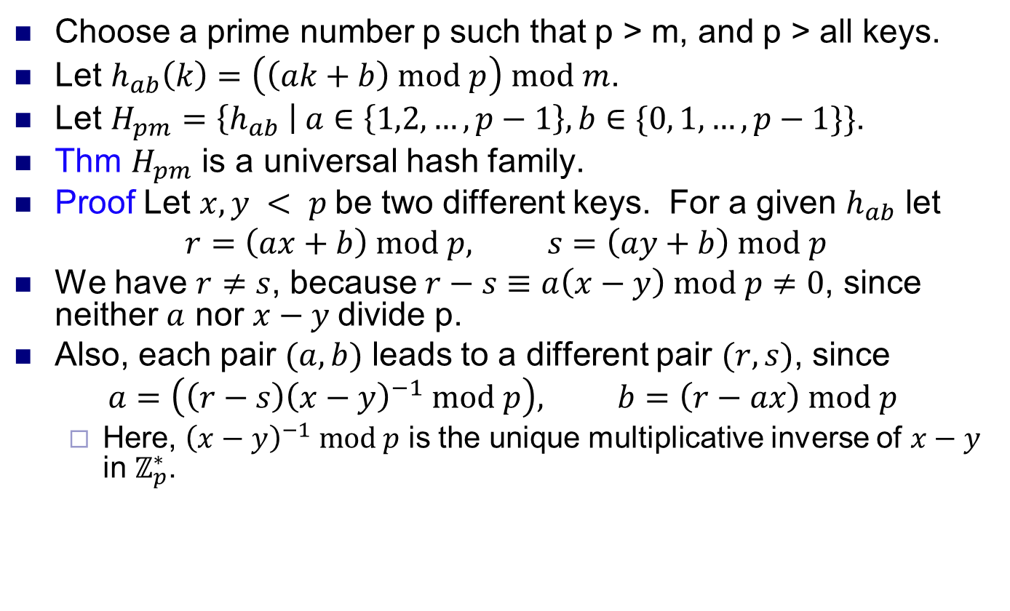
Constructing universal hash family 1
Choose a prime number p such that p > m, and p > all keys.
Let $h_{ab}\left(k\right)=\left(\left(ak+b\right) mod p\right) mod m$.
Let $H_{pm}=\left\{h_{ab} \right| a∈\left\{1,2,…,p−1\right\}, b∈\{0, 1, …, p−1\}\}$.
Thm $H_{pm}$ is a universal hash family.
Proof Let $x, y < p$be two different keys. For a given $h_{ab}$ let
$$r=\left(ax+b\right) mod p, s=\left(ay+b\right) mod p$$
We have $r≠s$, because $r−s≡a\left(x−y\right) mod p≠0$, since neither $a$ nor $x−y$divide p.
Also, each pair $(a,b)$ leads to a different pair $(r,s)$, since
$$a=\left(\left(r−s\right){\left(x−y\right)}^{−1} mod p\right), b=\left(r−ax\right) mod p$$
Here, ${\left(x−y\right)}^{−1} mod p$ is the unique multiplicative inverse of $x−y$ in $ℤ_{p}^{∗}$.

Slide 33
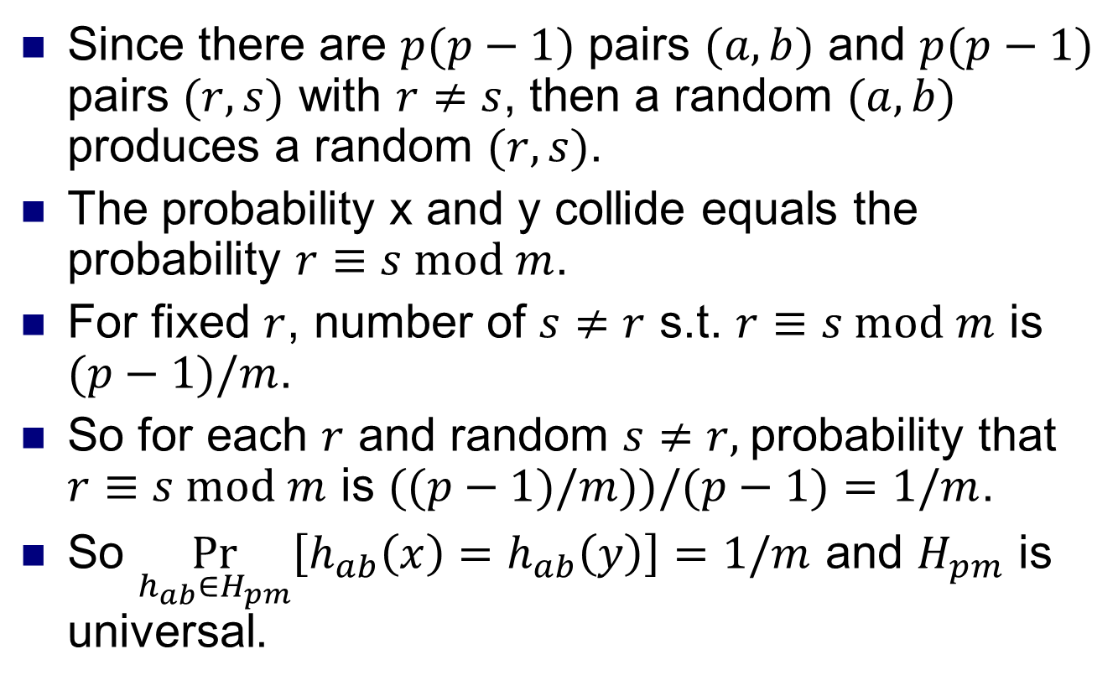
Constructing universal hash family 2
Since there are $p(p−1)$ pairs $(a,b)$ and $p(p−1)$ pairs $(r,s)$ with $r≠s$, then a random $(a,b)$ produces a random $(r,s)$.
The probability x and y collide equals the probability $r≡s mod m$.
For fixed $r$, number of $s≠r$ s.t. $r≡s mod m$ is $(p−1)/m$.
So for each $r$ and random $s≠r,$probability that $r≡s mod m$ is $((p−1)/m))/(p−1)=1/m$.
So $\underset{h_{ab}∈H_{pm}}{Pr}\left[h_{ab}\left(x\right)=h_{ab}\left(y\right)\right]=1/m$ and $H_{pm}$ is universal.

Slide 34
Perfect hashing
The hashing methods we’ve seen can ensure O(1) expected performance, but are O(n) in the worst case due to collisions.
However, if we have a fixed set of keys, perfect hashing can ensure no collisions at all.
Perfect hashing maintains a static set, and allows find(k) and delete(k) in O(1) time.
It doesn’t support insert(k).
Ex The fixed set of keys may represent the file names on a non-writable Blu-ray.

Slide 35
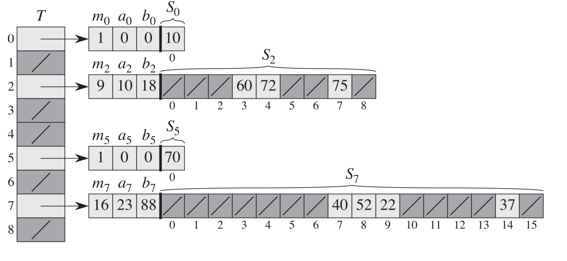
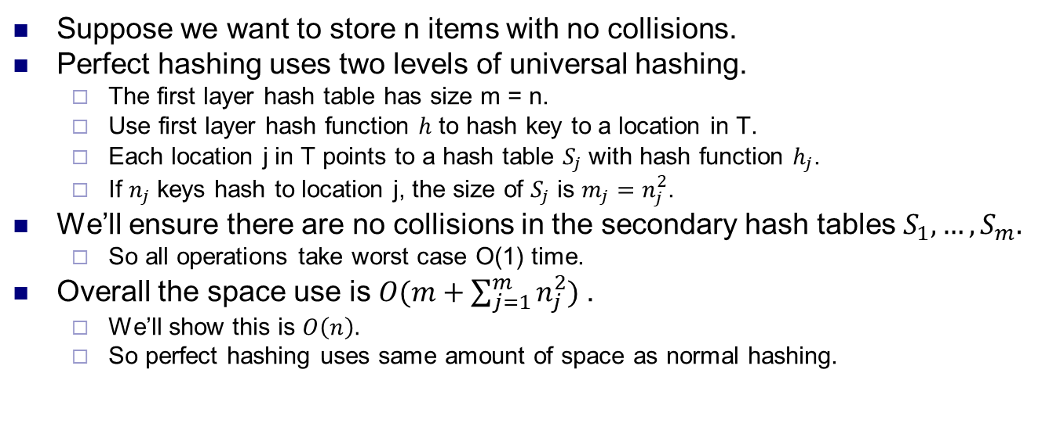
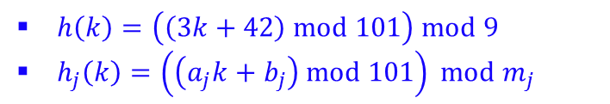
Perfect hashing
$h\left(k\right)=\left(\left(3k+42\right) mod 101\right) mod 9$
$h_{j}\left(k\right)=\left(\left(a_{j}k+b_{j}\right) mod 101\right) mod m_{j}$
Suppose we want to store n items with no collisions.
Perfect hashing uses two levels of universal hashing.
The first layer hash table has size m = n.
Use first layer hash function $h$ to hash key to a location in T.
Each location j in T points to a hash table $S_{j}$ with hash function $h_{j}$.
If $n_{j}$ keys hash to location j, the size of $S_{j}$ is $m_{j}=n_{j}^{2}$.
We’ll ensure there are no collisions in the secondary hash tables $S_{1},…, S_{m}.$
So all operations take worst case O(1) time.
Overall the space use is $O(m+\sum_{j=1}^{m}{n_{j}^{2}) }$.
We’ll show this is $O\left(n\right).$
So perfect hashing uses same amount of space as normal hashing.

Slide 36
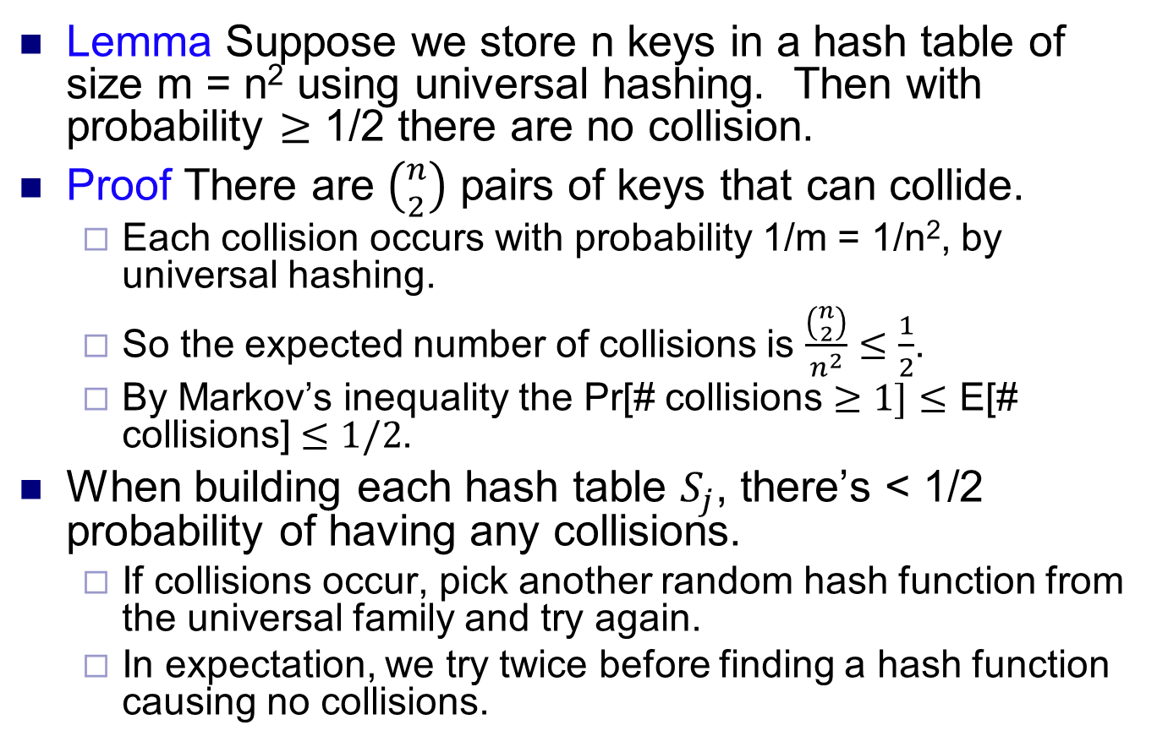
Avoiding collisions
Lemma Suppose we store n keys in a hash table of size m = n² using universal hashing. Then with probability $≥$ 1/2 there are no collision.
Proof There are $\left({n \atop 2}\right)$ pairs of keys that can collide.
Each collision occurs with probability 1/m = 1/n², by universal hashing.
So the expected number of collisions is $\frac{\left({n \atop 2}\right)}{n^{2}}≤\frac{1}{2}$.
By Markov’s inequality the Pr[# collisions $≥1]≤$ E[# collisions] $≤1/2$.
When building each hash table $S_{j}$, there’s < 1/2 probability of having any collisions.
If collisions occur, pick another random hash function from the universal family and try again.
In expectation, we try twice before finding a hash function causing no collisions.

Slide 37
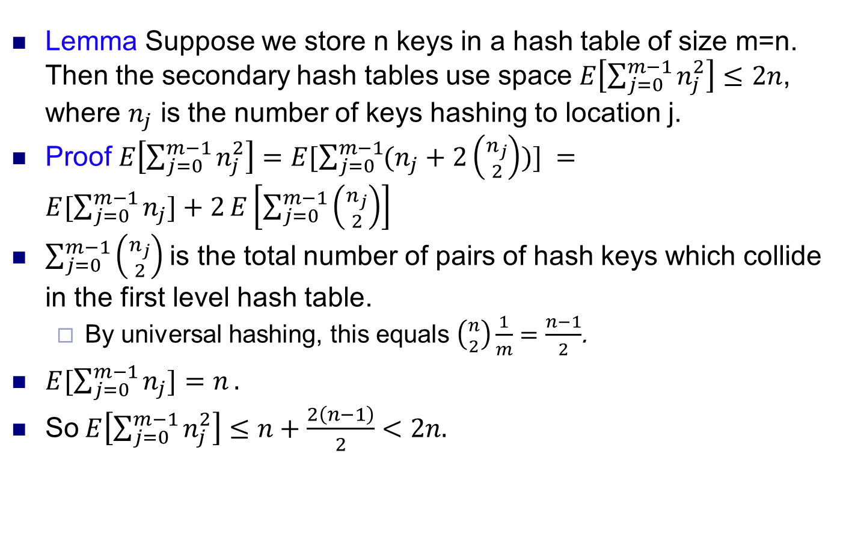
Space complexity
Lemma Suppose we store n keys in a hash table of size m=n. Then the secondary hash tables use space $E\left[\sum_{j=0}^{m−1}{n_{j}^{2}}\right]≤2n$, where $n_{j}$ is the number of keys hashing to location j.
Proof $E\left[\sum_{j=0}^{m−1}{n_{j}^{2}}\right]=E[\sum_{j=0}^{m−1}{(n_{j}+2}\left({n_{j} \atop 2}\right))] =E[\sum_{j=0}^{m−1}{n_{j}]+2}E\left[\sum_{j=0}^{m−1}{\left({n_{j} \atop 2}\right)}\right]$
$\sum_{j=0}^{m−1}{\left({n_{j} \atop 2}\right)}$ is the total number of pairs of hash keys which collide in the first level hash table.
By universal hashing, this equals $\left({n \atop 2}\right)\frac{1}{m}=\frac{n−1}{2}$.
$E[\sum_{j=0}^{m−1}{n_{j}]=n}.$
So $E\left[\sum_{j=0}^{m−1}{n_{j}^{2}}\right]≤n+\frac{2\left(n−1\right)}{2}<2n.$

